Slide 1
‘War In Peace’
… through Cyberspace
Conference on Current Security Threats
October 21, 2019
Chamber of Deputies of the Parliament of the Czech Republic
James Van de Velde, Ph.D.
Associate Professor, National Intelligence University
Adjunct Faculty Member, Georgetown and Johns Hopkins University
Strategist, US Cyber Command
Notes:
First, I wish to thank Mr. Pavel Žáček and the Government of the Czech Republic for their kind invitation. It is indeed an honor to be here and to celebrate our two country’s common and indomitable defense of freedom.
I know how important our alliance is and how our two nations face similar very security concerns.

Slide 2
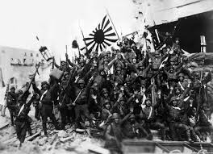
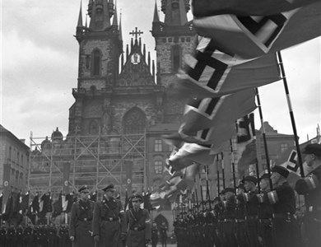
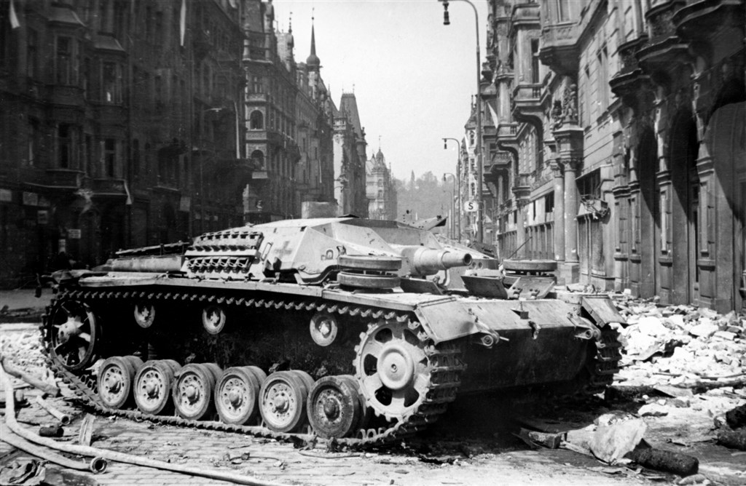
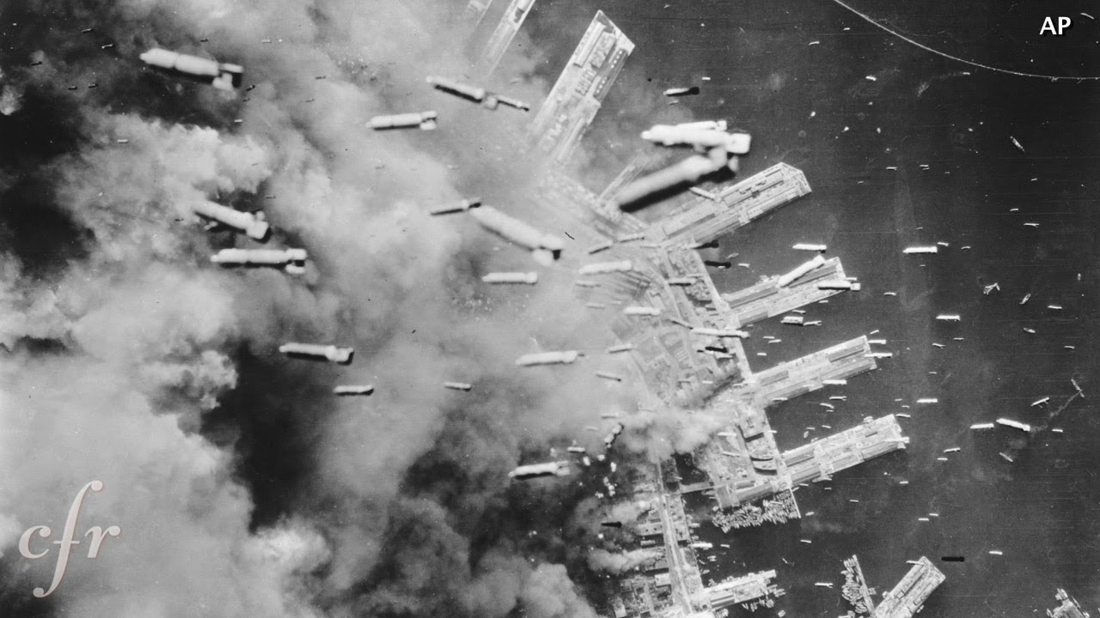
Notes:
What if warfare—the kind we see in World War II movies—never occurs again?

Slide 3
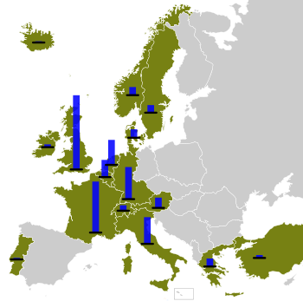
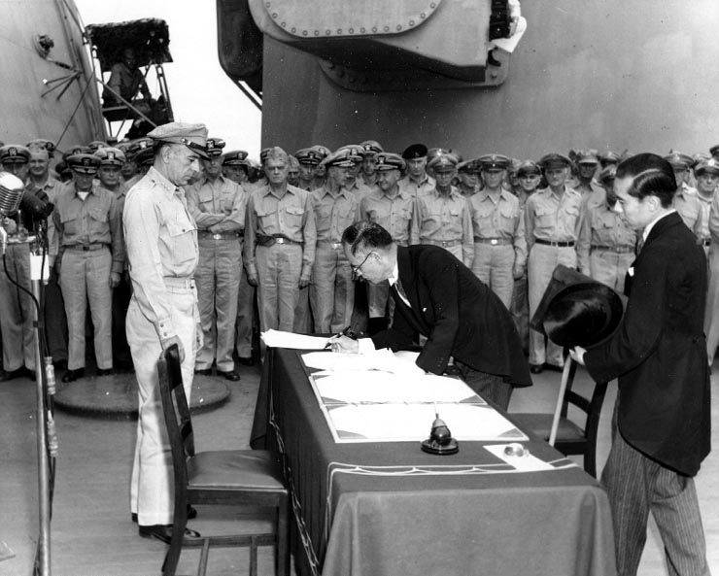
Warfare in the 20th Century …
Total, unambiguous, and definitive.
There was a beginning (a declaration), a prosecution of conflict, and a clear and declared end, including a postwar occupation and recovery.
Notes:
The two great wars of Europe were total, unambiguous, and definitive.
There was a beginning (a declaration), a prosecution of conflict, and a clear and declared end, including a postwar occupation and recovery.
Warfare today, however, seems almost always ambiguous, murky, confusing, ongoing, and politically complicated—especially for the very legalistic United States.

Slide 4
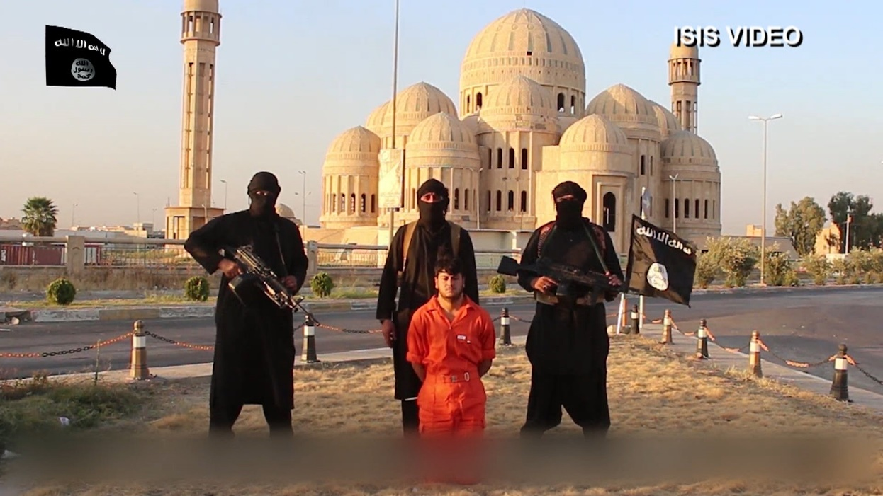
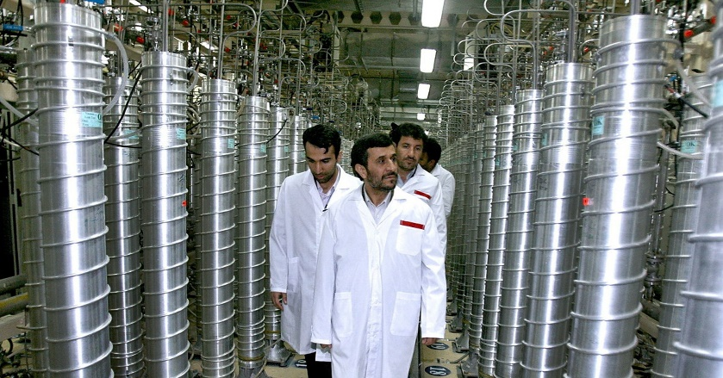
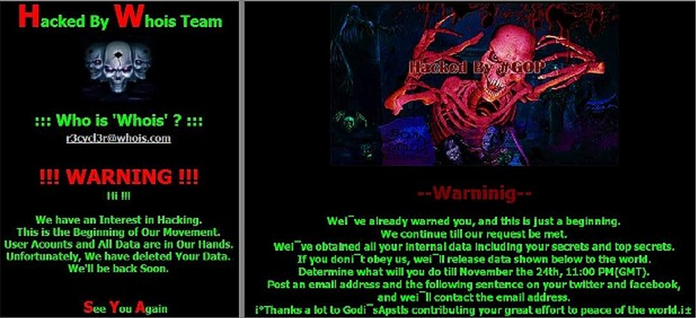
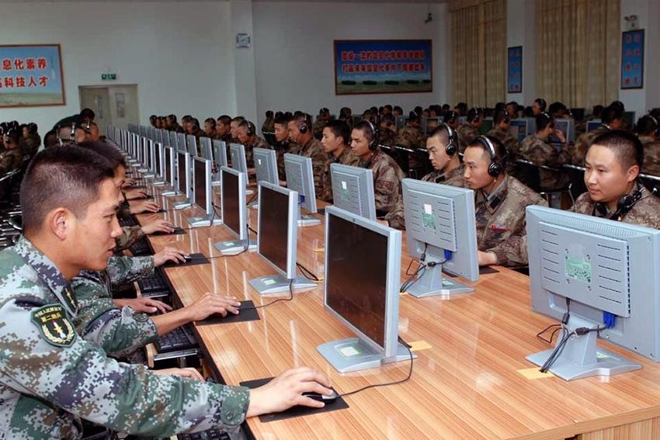
Warfare in the 21st Century …
Notes:
Warfare today is a combination of low-intensity (military) conflict and a fight over information and imagery via cyberspace— especially over “narratives” that sway public opinion.
This modern “warfare” is overlaid on great power competition and continuous operations below the level of armed conflict.

Slide 5
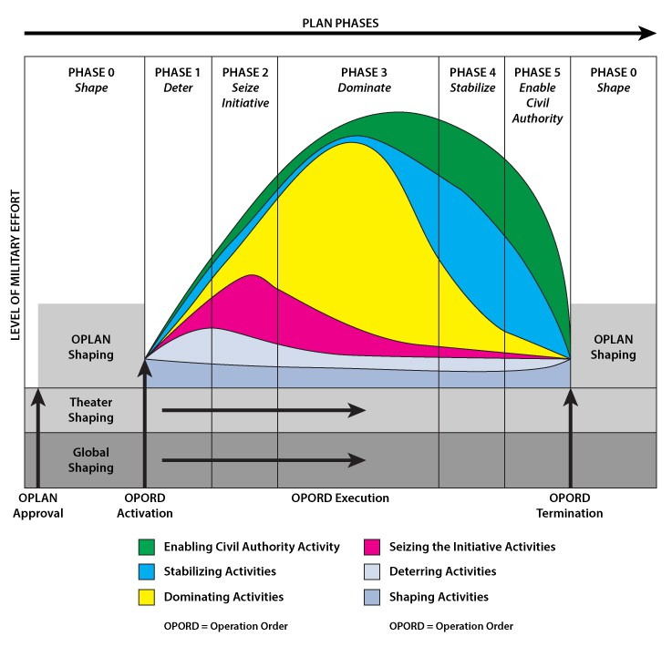
(Joint Publication 3-0, United States Joint Chiefs of Staff, August 11, 2011, p. V-6)
Notes:
Modern warfare is no longer unambiguous and linear, as displayed in the graphic depicting obsolete strategic planning from Joint Pub 3.0.
What is new is that our adversaries now specifically stay in the early stage of cyberspace operations, information operations, and very limited or no kinetic conflict, careful never to escalate to state-on-state conventional war.
In short, our adversaries and competitors have embraced cyber warfare -- in particular -- precisely to avoid kinetic hostilities with the west, but still achieve their political objectives.
No other domain loses so much power as does the cyber domain.
It is precisely because the west enjoys dominance in many military domains that its adversaries plan and struggle against western interests short of declared mass kinetic warfare, especially in cyberspace.
Cyberspace is a unique military domain in which the west and adversary forces meet and compete every day.

Slide 6
The New Warfare:
Strategic Coercion
The Grey Zone
Soft Power 2.0
Information Confrontation
Coercive Gradualism
Weaponized Information
Influence Operations
Information Operations
Information Warfare
Intelligent Warfare
Social-cyber attack
Great Power Competition
‘Little Green Men’
Operations ‘Below the Level of Armed Conflict’
=
Warfare In Peacetime
Notes:
Warfare today is the use of information and cyberspace to influence, to manipulate perceptions, emotions, stances and opinions to gain advantage, using unethical, malign, or deceptive techniques.

Slide 7
The New ‘Normal’ for Warfare in Peacetime:
From → To
Destruction → Influence
Annihilation of the Enemy → Opponent’s Decline
Conventional Force → ‘Whole-of-Government’ Forces
Battleground → Information Warfare
Direct Conflict → Indirect War
War in the Physical World → War via Cyberspace
Symmetric Warfare → Asymmetric Warfare
War in a Finite Period → Constant Contact
War over Territory → Struggle over Narratives
Declarations of War → Operations ‘below the level of armed conflict’
Notes:
Key influencers dominate/greatly influence debates.
Such key influencers create echo chambers that are particularly powerful.
By inflaming these echo chambers, these groups, these individuals becomes more susceptible to disinformation an become more emotional.
They cause the brain to lose contact with the rational side of the brain. One becomes highly emotional.
We’re seeing now a corrosive threat -- the ability to weaponize information in order to conduct influence operations, steal intellectual property, or leverage someone’s personally identifiable information.

Slide 8
China
Russia
Iran
North Korea
all engage in
Warfare In Peacetime

Slide 9
China
Russia
Iran
North Korea
Notes:
China weaponizes cyberspace and business, steals US intellectual property in the billions, and is integrating cyberspace to defend its notion of sovereignty to dis-inform and destabilize rivals, such as the Republic of Taiwan, Japan, and the United States. China will likely use cyberspace offensively when faced with likely kinetic conflict with adversaries, including the United States.
Russia conducts strategic coercion via cyberspace to undermine political rivals -- including the United States, taking advantage of or enhancing political divisions within democracies in order to weaken them overall.
Russia applies the ‘3Ds’ strategy:
cyberspace-delivered Disinformation,
political Destabilization (often delivered via cyberspace), and
(threat of) physical Destruction
Iran uses cyberspace to deliver asymmetrical attacks, to distract adversaries, cause them to turn inward or to punish them for perceived damages Iran claims they have caused.
North Korea conducts cyber-crime in order to sustain its totalitarian regime and more specifically its nuclear program. Cybercrime allows it to survive its failed-state status. North Korea may not have survived this decade had the internet not afforded it the means for massive, global theft.
A December 2018 US Army study entitled, The US Army in Multi-Domain Operations 2028, written under Gen. Mark Milley, then Army Chief of Staff and now the new Chairman of the Joint Chiefs of Staff, sees Russia and China “contesting the information environment” where “U.S. dominance is not assured.”
The study claimed that the United States is “in a state of continuous competition [with] China and Russia [who] exploit the operational environment to achieve their objectives without resorting to armed conflict by fracturing the U.S.’s alliances, partnerships, and resolve.
They attempt to create stand-off through the integration of diplomatic and economic actions, unconventional and information warfare (social media, false narratives, cyber attacks), and the actual or threatened employment of conventional forces.”

Slide 10
China
The internet is a tool to protect the Party, advance economic growth through theft of technology, exert control over political competitors and Western influence, and aid the Chinese military in future conflicts.
Internet “sovereignty” to China is Party control of information.
Notes:
The Chinese Government believes in internet freedom—that is, freedom from Western online influence.
That means YouTube, Facebook, Fox News, the BBC, and Voice of America are toxic to the Chinese Government and viewed as violations of Chinese sovereignty.
Internet “security,” meanwhile, is the defense against any online activity that threatens Party rule.
China views U.S. manufacturing not as a competitor to Chinese industry but a resource to mine for proprietary and business information through cyberspace to advance China’s economy and modernize its industry and military.
The internet is a tool to protect the Party, advance economic growth, exert control over political competitors and Western influence, and aid the Chinese military in future conflicts.
The Chinese government considers private Western websites to be weapons that deliver the dangerous toxin of Western influence; it doesn’t care that the delivery vehicle is a private entity or that competing speech can easily be found or added online.
It thinks our acceptance of speech we don’t like (even on private websites) is a sign of weakness and leads not to a stronger state but to a decadent populace.
Internet “sovereignty,” to the government of China, is the control of information within its borders.

Slide 11
China’s Internet Activity
The Chinese conduct three types of state-sponsored cyber activity:
National Security Espionage
Intellectual property Theft to Aid Chinese Industry
Internal Information Operations Designed to Control and Manipulate What the Chinese People Can View and Say Online
Notes:
The Chinese conduct three types of state-sponsored cyber activity:
national security espionage (which all nations conduct);
cyber-enabled intellectual property theft to aid Chinese industry (an illegal activity, and adamantly opposed by the United States); and
internal information operations designed to control and manipulate what the Chinese people can view and say online (anathema to the United States and other democracies).
Chinese espionage includes stealing U.S. government secrets, information regarding members of the U.S. intelligence community, the blueprints of U.S. weapon systems, and the details of U.S. national security strategy.
Economic espionage consists of the theft of intellectual property and sensitive business information to aid Chinese industry and trade negotiations.
China views U.S. manufacturing not as a competitor to Chinese industry but a resource to mine for proprietary and business information through cyberspace to advance China’s economy and modernize its industry and military.
Chinese economic espionage is greater than the economic espionage conducted by all other states against the United States combined.
Information operations are conducted continuously against China’s own people, led by the “Golden Shield Project” (a.k.a. the Great Chinese Firewall)—a massive censorship and surveillance system operated by the Ministry of Public Security.
This government cyberspace tool attacks and blocks certain websites, poisons caches, conducts speech and face recognition, and sucks in closed-circuit television, smart cards, credit cards, and other surveillance technologies.
It also indexes content around the world (in anticipation of filtering it when it heads to China), filters incoming content, and blocks pro-democracy groups and certain related content (such as anything to do with the Dalai Lama, Falun Gong, or Taiwan), along with any news stories that embarrass the government.
In addition, it blocks Voice of America and many Western news sites, such as the Chinese edition of the BBC.
The Chinese government uses the internet to conflate nationalism and Party rule and to justify the righteousness of the Party’s existence.
It portrays the Great Chinese Firewall as a form of paternal protection from the prurient West.

Slide 12
  China’s Information Confrontation
  ‘Equivalency’ is China’s (near term) political goal:
    “The Chinese and the Americans both spy on you. What’s the difference?”
    “China has lifted millions out of poverty and has a lower crime rate than America.”
    China as benevolent, reserved, intelligent
  China’s goal is ‘narrative dominance’
Notes:
China is now engaged in Russian-style Information Confrontation
China will likely conduct overt and covert operations to influence voters on China-specific issues over trade, Iran, technology, to influence political leaders.
China may not necessarily select a preferred candidates but will engage in negative operations.
Equivalency arguments is China’s goal .
“The Chinese and the Americans both spy on you. What’s the difference?”
“China has lifted millions out of poverty and has a lower crime rate than America.”
And much of this equivalency goal is mere acquiescence of Chinese progress – the inevitability of Chinese dominance.
China’s strategic goal is ‘narrative dominance’

Slide 13
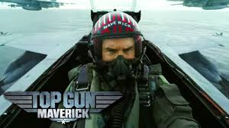
Notes:
In the upcoming 2020 movie ‘Top Gun: Maverick,’ US actor Tom Cruise reprises his role as US Navy fighter pilot Pete Maverick.

Slide 14
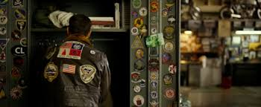
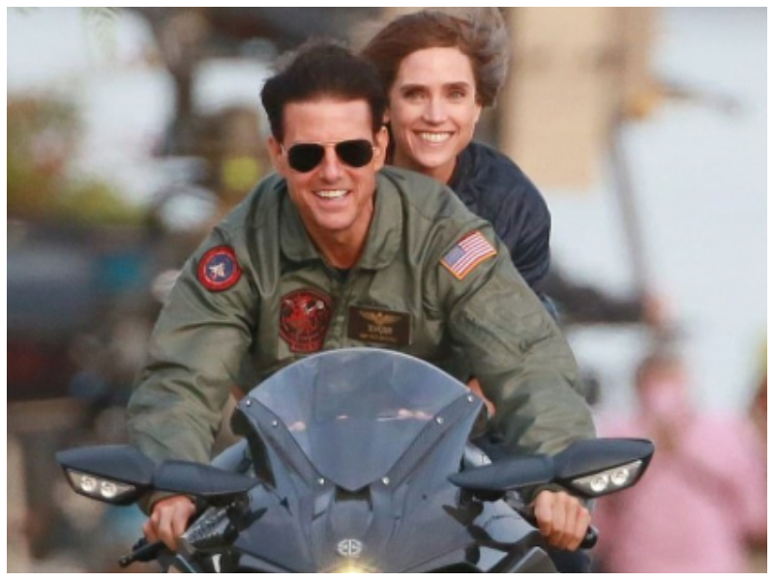
Notes:
The trailer for the movie includes a reprise of iconic scenes from his 1985 movie, including a motorcycle ride and his fighter pilot jacket.

Slide 15
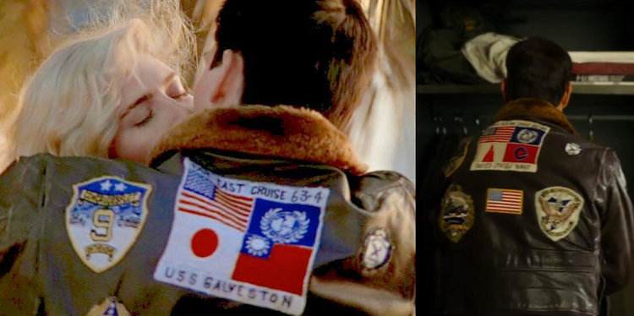
Notes:
But there is one problem. The jacket he wore in 1986 had a large patch that read "Far East Cruise 63-4, USS Galveston," commemorating a real-life US battleship's tour of Japan, Taiwan, and the Western Pacific. The patch displayed the US, UN, Japanese, and Taiwanese flags.
The new jacket does not include the flags of Japan or Taiwan.

Slide 16

Notes:
In the 2013 fantasy movie, Gravity, Russia uses a ground-based direct ascent anti-satellite weapon to destroy a satellite in space to demonstrate its anti-satellite capability.

Slide 17
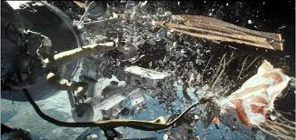
Notes:
The test causes a chain reaction of destruction in space, destroying the US space shuttle, most of its crew and wiping out many space satellites.

Slide 18
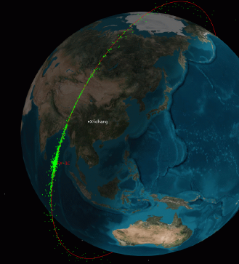
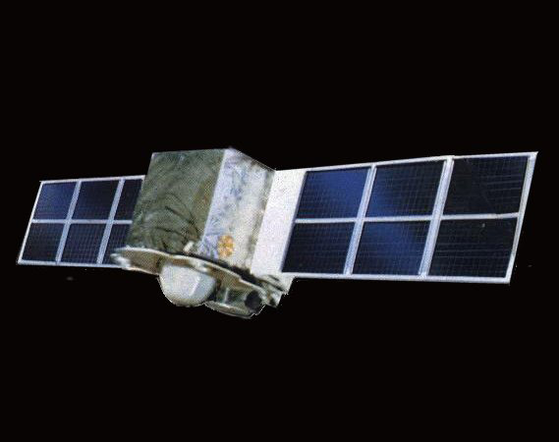
Notes:
But it was China, not Russia, that, in 2007 shot an aging weather satellite in space with a ground-based interceptor, causing a debris field that exists today.
The movie Gravity made $70 million in China; it made $21 million in Russia.

Slide 19

Notes:
In the movie, The Martian, a secret Chinese space project comes to the aid of the US effort to save a stranded US astronaut on Mars.
The Chinese National Space Agency has a secret rocket booster capable of making the journey to Mars and saves American Matt Damon.
Toward the movie’s end, the Chinese National Space Agency leadership is seen standing next to NASA officials, celebrating the joint operation.
Why did China have to be in the movie at all? And why China and not Russia, Japan, India, or the European Union?
The movie made $95 million in China.

Slide 20

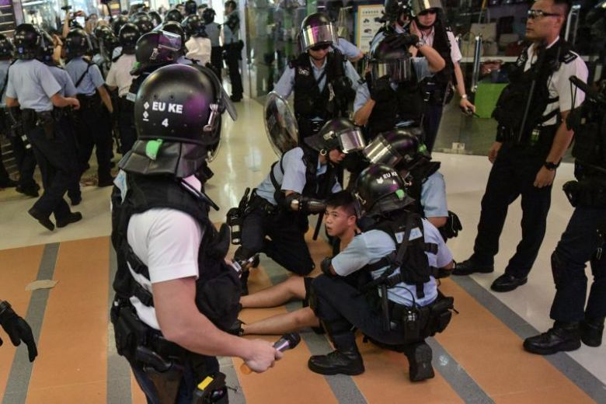
Notes:
Actress Liu Yifei, who is set to play the warrior in the upcoming Disney film, Mulan, posted a message on Chinese social-media site Weibo in support of the police in Hong Kong.

Slide 21


Notes:
The Chinese government likens the actions of the protestors to that of terrorists.
The Beijing Government claimed the United States is behind the movement.
Liu Yifei, the daughter of a communist Chinese diplomat, petitioned to become an American citizen.
She was ranked 23rd on Forbes China Celebrity List in 2017, and 89th in 2019.
She is reportedly worth today $10 million.
The daughter of a Chinese communist diplomat applied for and received US citizenship.

Slide 22

Notes:
She has 22,000 twitter followers.
(I have 170.)

Slide 23
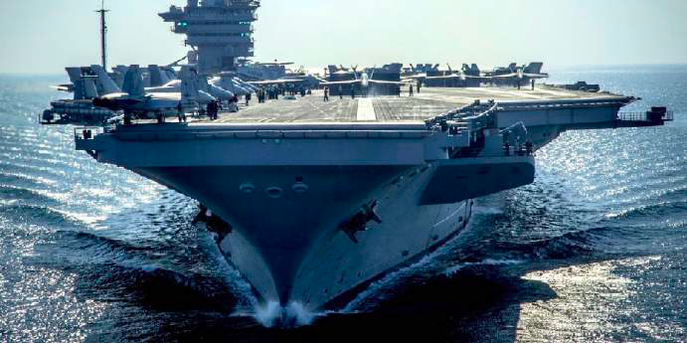
=
Notes:
A Chinese conglomerate, Dalian Wanda Group, bought the American movie distribution company, AMC in 2012.
It also bought the movie production company Legendary for $3.5 billion – the cost of one Nimitz class aircraft carrier.
When was the last time you saw a movie with a Chinese villain?

Slide 24
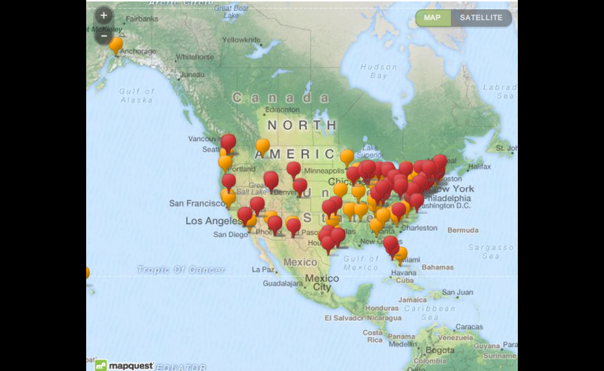
Notes:
More than 100 American colleges and universities house Confucius Institutes, centers of Chinese language and cultural teaching, funded and staffed in part with instructors screened by a Chinese government-affiliated agency.
A report on these Confucius Institutes from the US National Association of Scholars, finds that “US universities have made improper concessions [to China] that jeopardize academic freedom and institutional autonomy.”
China uses information as a decision advantage.
It uses its rich culture and economic resources as a carrot to entice cooperation.
There are 500 such institutes Worldwide.
The Chinese publication, National Defense in a New Era, claims that “intelligent warfare” is on the horizon.

Slide 25
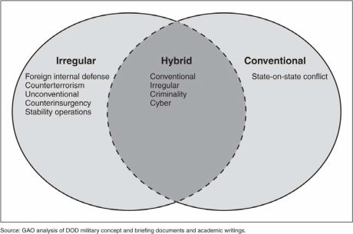
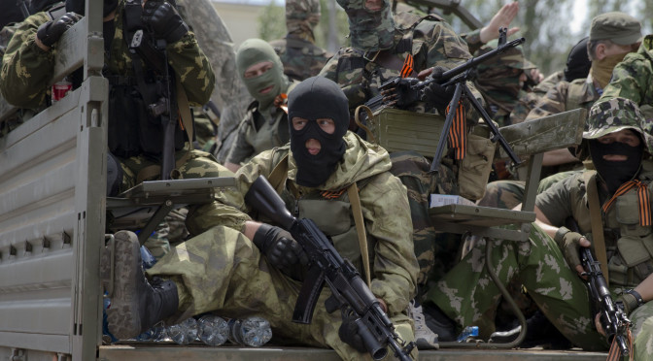
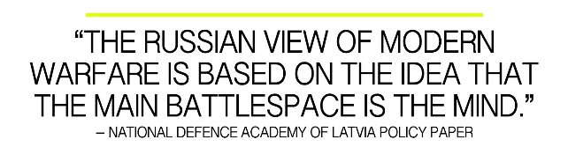
Russia’s Hybrid (‘3D’) Warfare
Three broad elements to Russian hybrid warfare
‘Information Confrontation:’ disinformation and planted information
Clandestine Political (physical) Destabilizing Operations
Russian conventional forces, which posture along the border to intimidate the targeted country, supply separatists, and occasionally intervene clandestinely (little green men)
Once the targeted country sees what it is facing, it agrees to a compromise that sacrifices elements of its sovereignty.
Notes:
The three broad elements of Russia’s hybrid warfare include:
Information confrontation (Soviet “active measures”) include disinformation and planted information. Soviet-like themes of anti-Nazism, the threat to Russian civilization, and the struggle against Western “informational aggression” and Western ‘destabilization strategy’ against Russia.
Clandestine destabilizing operations that focus on small sectors of a targeted country’s political apparatus by seizing certain public media and state communications, attacking certain facilities and smearing them as oppressive agents of an illegitimate state, and supplying weapons to separatists (see Estonia in 2007, Georgia in 2008, and Ukraine in 2014).
The posturing of Russian conventional forces posture along the border to intimidate the targeted country’s military, supply the separatists, and occasionally intervene directly inside its borders.
This form of warfare is designed never to develop into a full-scale conventional war with the targeted country, and certainly not with NATO.
Russia’s hybrid warfare begins and ends in the early phases of warfare without reaching kinetic conflict with powerful adversaries.
By creating a new status quo, Russia successfully breaks international norms, creates indistinct (and new) borders, and lowers international expectations about its behavior.
By making the conflict politically ambiguous, claiming no direct involvement, and keeping hostilities small and protracted, Russia keeps outside players like NATO and the United States weak, off-balance, and confused.
Russia fuses psychological with kinetic operations to cloud its adversaries’ and Western perceptions of the conflict
Information is not used to persuade but to confuse, paralyze, and subvert.
“Information troops” are now the primary driver of Russian military aggression.
Russia spends more on state propaganda than any other. Propaganda has not served to make target populations pro Russia; instead it has served to confuse and hide the truth.
The weaponization of information, culture and money is a vital part of the Kremlin’s hybrid warfare.

Slide 26
Russia
Support for specific Western candidates does not necessarily correspond with support for pro Russian candidates
The goal is not to advance Putin’s agenda; it is to advance US decline, political doubt, and paralysis
Putin’s hope for the United States is decline; Putin ‘supports’ no US candidate
Moscow will support any candidate worldwide who advances Western decline
Notes:
The US media is obsessed with the fact that Russian 2016 efforts seemed more numerous in favor of candidate Trump.
Even if Russian efforts in number in 2016 favored candidate Trump, this does that mean President Putin now wishes President Trump to succeed in rebuilding the US military, rebuild US credibility, or restore US economic growth.
Americans think in terms of winners and losers.
Its hard, especially for the American left, to conceive that Russia may have opposed candidate Clinton merely out of spite (for her support of Putin’s political adversaries) or to weaken America generally.
And now that President Trump has delivered on his campaign promises generally and successfully, who do you suppose President Putin favors in 2020: Donald Trump or the likely democrat challenger?
Russian political warfare is re-emerging in doctrine and practice.
Its emphasis is on use of non-military means to influence decision makers, organizations, people and their behavior to meet Russian objectives.
This weaponized disinformation erodes public support for Euro-Atlantic values, impeding and distorting U.S. and European decision-making.
It is a force multiplier for Russia, which in terms of economic heft and military might is far weaker than the countries of the EU or NATO.
While Russia’s use of disinformation long predates the current Ukraine crisis, its sophistication, intensity, reach and impact are increasing.

Slide 27
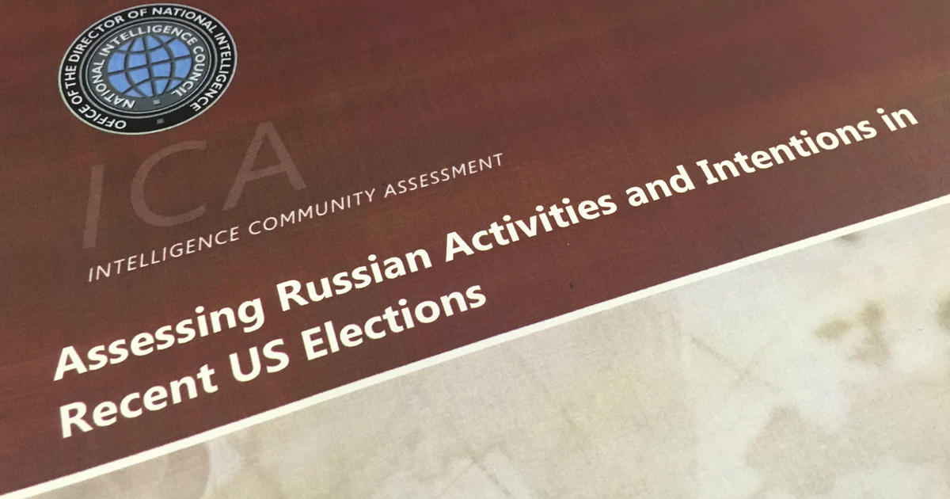
“Russia’s intelligence services conducted cyber operations against targets associated with the 2016 US presidential election, including targets associated with both major US political parties. …In July 2015, Russian intelligence gained access to Democratic National Committee (DNC) networks and maintained that access until at least June 2016.
The General Staff Main Intelligence Directorate (GRU) probably began cyber operations aimed at the US election by March 2016. We assess that the GRU operations resulted in the compromise of the personal e-mail accounts of Democratic Party officials and political figures. By May, the GRU had exfiltrated large volumes of data from the DNC.”
Assessing Russian Activities and Intentions in Recent US Elections, Intelligence Community Assessment, Office of the Director of National Intelligence, ICA 2017-01D, 6 Jan 2017, p. 2.
Notes:
Russia brands liberal democracy as American imperialism and wishes to replace American leadership with Russian influence wherever possible.
Russia’s chief weapon is its cyberspace capability, which is formidable, which it uses to manipulate opinion.

Slide 28
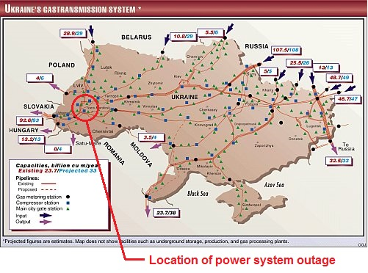
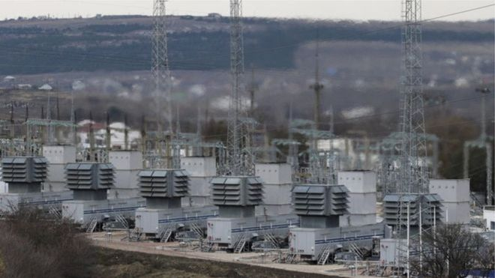
Notes:
The December 2015 cyber-attack against Ukraine’s electrical was designed to make the Ukrainian Government look incompetent, unstable, and less attractive to Western investment and support.
Russia’s creates ambiguity and confusion within a targeted society, ultimately undermining faith in the country’s political institutions and leaders (thereby weakening them).
Russia fuses psychological warfare with kinetic intimidation to shape or confuse an adversary.

Slide 29
2016 RUSSIAN INTERFERENCE IN US ELECTIONS | VIOLATION OF SOVEREIGNTY | ARMED ATTACK | ‘ACT OF WAR’
Information Operations (fake social media messages only; involving no unauthorized access) (assessed by the US Intelligence Community) | No | No | Not declared
Unauthorized access/espionage (assessed by the US Intelligence Community) | Yes | No | Not declared No precedent; not likely
Unauthorized manipulation of voting technology (not assessed by the US Intelligence Community) | Would have been | Technically yes, though likely not publicly described as ‘armed attack’ | Unlikely, but up to the President
Unauthorized destruction or manipulation of information leading to destruction or death (not assessed by the US Intelligence Community) | Would have been | Would have been | Could be so claimed by the President, though no cyberspace operation has to date been declared an act of war
Notes:
What constitutes violations of sovereignty, armed attack, or ‘acts of war’ via cyberspace?
This does not represent an official US view, but I think it is very close to how the United States Government views such acts.

Slide 30
The trends in cyberspace are not necessarily good
Notes:
China is also now ‘out-cycling’ the United States and may soon perform acquisition faster than the United States can develop and field new defense technology.
This means China may soon be able to steal US technological plans via cyberspace and develop counter measures to US defenses faster than the US can conceive of and field ‘Third Offset’ technology – technology that aims to generate and sustain strategic advantage by acquiring technologically more-advanced weapons to defeat adversary advancements.
China will soon outnumber US forces in every sector, including cyberspace forces. The United States, therefore, will have to discern an asymmetrical cyberspace strategy toward China and perhaps Russia and Iran too, as these states place the highest priority on advancing and funding their cyberspace forces.
Worse, all these states share a common political enemy and cyberspace nemesis: the United States and NATO.
Russia sees no guardrails in cyberspace. It uses Ukraine as a cyber test bed to conduct offensive operations against the Ukrainians. But Russian offensive cyberspace operations sometimes spill out of Ukraine to infrastructure in other states
The introduction of artificial intelligence may permit an automated and masked approach to offensive cyberspace activity by the malicious cyber states .
If AI can discern vulnerabilities autonomously and attack through them, AI will usher in a new area of constant adversary attack, not just an era of persistent competition. It is not a coincidence that the states that are heavily investing in AI are Russia and China.
The near future of cyberspace is Balkanization (aka ‘splinterization’) – the fracturing and dividing of internet networks into separate, independent networks, usually defended by a firewall.
This Balkanization is being driven by the authoritarian states of the world (Russia, China, Iran, North Korea) who wish to control information inside their borders and enable and harbor criminal cyber activity focused against the United States, as well steal Western industrial technology, which they will want to protect, once stolen.

Slide 31
?
Notes:
What does it mean to ‘win in peacetime?’
What is ‘winning in peacetime?’

Slide 32
You Get the Behavior You Reward (or do not punish)
NATO states cannot achieve the outcome they desire without conditioning the behavior they expect.
The United States cannot defend international norms unless it exercises cyber capabilities.
What is the right balance of information warfare ‘offense’ vs ‘defense?’
Notes:
NATO states cannot achieve the outcome they desire without conditioning the behavior they expect.
How to respond has proven difficult for the West so far:
How far should we concentrate on “offense” – attacking into Russia’s information space – and how far on “defense” – rebutting Russian propaganda and disinformation?
Whose job is it to push back: The United States alone, NATO, the EU, nation-states or NGOs?
And who ‘fights’ these wars of information? Diplomats or the military?

Slide 33
How to Compete in Peacetime
Passivity (Doctrine of Restraint) leads to escalation of adversary information warfare
Costs must be imposed for the violation of international norms.
Notes:
The era of noble restraint in cyberspace during the Obama Administration is over. GEN Nakasone, CDR, US Cyber Command, has announced that the United States is pursuing a strategy of persistent engagement of the malicious cyber actors.
The United States and its allies should pursue nonviolent, cost imposing options across economic, political, and military areas to stress, overextend and unbalance adversary states at home and abroad.
Regime survival is always these adversary state’s primary objective.
Authoritarian states cannot survive without provocations and agitating against alleged enemies. In other words, these states are not going to stop.
What Can Be Done
Release much more intelligence. Sacrifice some methods at strategic times in order to defeat adversary information warfare. (Much cyber intelligence is perishable anyway; accesses that exist today may no always exist. Therefore, it may be better to sacrifice some at certain times in order to achieve a strategic effect of exposing an adversary.)
Expose adversary narratives and influence warfare. Expose targeted audiences to weaponized information.
Educate targeted populations with the fact of Chinese and Russian weaponized information.
Encourage critical thinking.
Make sure Article 5 can apply to forms of Russian ‘hybrid warfare’ and Chinese intelligence warfare. Support NATO states under attack.
Reveal adversary strategies and talk about them.
Russia
Conduct counter messaging against Russian cyberspace operations such as
public shaming (exposing government false Russian statements);
counter–trolling (hire firms to counter Russian troll farms);
op-eds, conferences, articles on Russian Information Confrontation and hybrid warfare;
lists of paid Russian trolls and phony experts;
register government-supported media as agents of the state (RT TV; Sputnik; the Russian Mir Foundation).
kick out fronts of the Russian government posing as NGOs.
Defend NATO states’ cyber infrastructure from Russian control and infiltration.
Invite EUCOM to request assistance from US Cyber Command.
Make sure Ukraine emerges as a stable, healthy democracy aligned with the EU.
Support Open Source companies, such as Bellingcat in the UK.
China
Seize moral high ground: Note that China uses cyberspace to become a modern police state; it is emulated by no one. No one wants to be like the Chinese state; people just want Chinese money.
Expose Chinese Soft Power 2.0, intelligence warfare and weaponized business practices. Publicly shame China continuously for stealing intellectual property.
Impose economic sanctions on China for its intellectual property theft, in accordance with existing laws.
Take the economic loss of Chinese intellectual property theft to the World Trade Organization.
Brand China as a pirate state for its wanton theft of intellectual property as part of a coordinated effort with allies, integrating diplomacy, politics, and legal action that takes China to the World Trade Organization under the TRIPS Agreement and obtain a legal judgment against it.
The WTO does not permit class actions, but nations can coordinate individual suits. (TRIPS: Trade-Related Aspects of Intellectual Property Rights -- an international legal agreement between all the member nations of the World Trade Organization (WTO).)
Give favored trade status to states that do not conduct intellectual property theft.
Expose Chinese use of debt traps which are cynical attempt to control states via extortion
Expose Chinese efforts to turn African nations into economic slaves through its manipulate loans programs (which are greatly aided by its cyberspace espionage).
Inform companies that their technology cannot be protected if they are in China.
Brand China an outlaw state for using its economic power to gain entry into the management of technology companies for the purpose of stealing their propriety information and trade secrets
Brand China as a repressive, dictatorial cyber state for its information control of its Muslim minority.
Conduct more offensive counter intelligence operations to poison Chinese industrial technology theft.

Slide 34
How to Fight During Peacetime
The West must adapt to this era of persistent confrontation via cyberspace.
The West must develop overt counter narratives to expose adversary hypocrisy.
Notes:
The West must adapt to this era of persistent confrontation via cyberspace.
The West must develop counter narratives:
Russia’s claim to oppose fascism is at odds with its support for Venezuela, Iran and its support for fascist political groups ins Europe. Unlike Soviet support for leftists, Russia support groups it thinks are subversive.
Russia’s complaint that the West involved itself in the affairs of other states is in stark contradiction with its intervention in Ukraine, the annexation of Crimea, its influence in Belarus and in all of its neighboring states.
China’s complaint of Western involvement in its internal affairs is at odds with its domination of Tibet, its suppression of Muslims, its penetration of Taiwan, and its extortion of neighboring states.

Slide 35
Cost imposing measures:
Economic measures
Geopolitical measures
Selected military deployment measures
Notes:
Cost imposing measures include:
Economic measures (specifically boosting U.S. energy production and sanctions) offer highest benefit, at the lowest risk, with the greatest likelihood of success.
Geopolitical, ideological & nuclear changes measures to extend Russia tend to come with the highest risks of unwanted second-order effects.
Selected military deployment measures may prompt additional Russian investments (e.g., those that threaten its A2/AD capabilities), but many other measures are limited by the fact that Russia is not seeking military parity with the United States.

Slide 36
Cost imposing measures, specifically:
Geopolitical
Provide lethal aid to Ukraine
Promote liberalization in Belarus
Expand ties in the South Caucasus
Flip Moldova
Ideological
Diminish faith in the Russian electoral system
Create perception that the regime is not pursuing the public interest
Encourage protests and other non-violent resistance
Undermine Russian image abroad
Economic
Expand U.S. energy production
Increase Europe’s LNG import capacity
Deepen sanctions
Enhance Russian brain drain
Notes:
Specifically:
Geopolitical
Provide lethal aid to Ukraine
Promote liberalization in Belarus
Expand ties in the South Caucasus
Flip Moldova
Ideological
Diminish faith in the Russian electoral system
Create perception that the regime is not pursuing the public interest
Encourage protests and other non-violent resistance
Undermine Russian image abroad
Economic
Expand U.S. energy production
Increase Europe’s LNG import capacity
Deepen sanctions
Enhance Russian brain drain

Slide 37
Cost imposing measures, by domain:
Air
Space and nuclear
Maritime
Land
Cyber
Multi domain
U.S. Investments in New Capabilities to Manipulate Russian Risk Perceptions
Notes:
Military domain specific:
Air
Advances in high-speed anti-radiation missile (HARM), RPAs and long range cruise missiles to challenge Russia’s A2/AD envelope
Reposture bombers
Reposture fighters
More low-observable aircraft
More autonomous/remotely piloted aircraft
More longer-range cruise missiles
More sophisticated Electronic Warfare
Focus on long-range, precision-guided conventional missiles (e.g., CPGS)
Space and nuclear
Deploy additional tactical nuclear weapons in Europe
Reorient BMD
Focus on space-based weapons
Focus on “spaceplanes”
Focus on small satellites
Break out of nuclear arms control regime
Maritime
Increase U.S. and allied naval force posture and presence
Increase naval research and development
Shift nuclear posture toward SSBNs
Check the Black Sea buildup
Land
Increase U.S. and NATO Land Forces in Europe
Increase U.S. forces in Europe
Increase European NATO member ground capabilities
Deploy large NATO forces on Russia’s borders
Increase NATO Exercises in Europe
Increase U.S. participation
Generate mass mobilization of European NATO member forces
Hold exercises on Russia’s borders
Hold exercises practice counter-attack or offensive scenarios
Multi domain
U.S. Withdrawal from the INF Treaty
Fund missile development program without withdrawing
Withdraw and build missiles, but do not deploy to Europe
Withdraw, build missiles, and deploy them to Europe
U.S. Investments in New Capabilities to Manipulate Russian Risk Perceptions
Incremental improvements in counter A2/AD capabilities (e.g., enhanced ATACMS/AARGM/ IFPC2)
Invest in revolutionary, swarm counter A2/AD capabilities
Invest in incremental improvements in counter-ground forces/fires (e.g. enhanced Javelin)
Invest in revolutionary, unmanned ground forces/fires capabilities
Invest in weapons based on “new physical principles” (e.g., directed energy counter air-defense weapons)

Slide 38
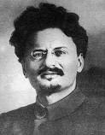
‘You may not be interested in intelligent warfare, but intelligent warfare is interested in you!’
Notes:
I conclude by paraphrasing Leon Trotsky, ‘You may not be interested in intelligent warfare, but intelligent warfare is interested in you!’

Slide 39
James R. Van de Velde, Ph.D. jamesvandevelde@yahoo.com

